Slide 1
forecasting the closing prices of Yes Bank stock
Yes Bank stock
Presented By:
Pavan Kumar Ramanadham - NRI Institute of Technology

Slide 2
OUTLINE
Proposed System/Solution
Problem Understanding and Background
Data Acquisition and Preparation
Exploratory Data Analysis (EDA)
Model Development
Model Evaluation and Validation
Prediction and Analysis
Deployment and Monitoring

Slide 3
Problem Statement
Example: Yes Bank is a well-known bank in the Indian financial domain. Since 2018, it has been in the news because of the fraud case involving Rana Kapoor. Owing to this fact, it was interesting to see how that impacted the stock prices of the company and whether Time series models or any other predictive models can do justice to such situations. This dataset has monthly stock prices of the bank since its inception and includes closing, starting, highest, and lowest stock prices of every month. The main objective is to predict the stock’s closing price of the month.

Slide 4
Proposed Solution
The proposed system aim to develop a robust predictive model for forecasting the closing prices of Yes Bank stock. By leveraging advanced machine learning techniques and thorough data analysis, we strive to provide valuable insights and recommendations to investors and stakeholders in the financial market. The solution will consist of the following components:
1.Data Collection:
Collect historical daily stock price data for Yes Bank from reliable sources like Yahoo Finance or directly from stock exchange APIs.
Include additional relevant features such as trading volume, market indices, and economic indicators.
2.Data Preprocessing:
Handle missing values by imputation or deletion based on data characteristics. Detect and remove outliers that could distort model performance.
Perform feature engineering to extract valuable information such as moving averages, technical indicators, and sentiment scores. Normalize or scale the data to ensure uniformity across features
3.Model Selection and Development:
Experiment with various machine learning algorithms suitable for regression tasks, including Linear Regression, Random Forest, Gradient Boosting, and Long Short-Term Memory (LSTM) for time series forecasting.
Split the dataset into training, validation, and testing sets to ensure robust model evaluation. Train each model on the training data and fine-tune hyperparameters using techniques like grid search or random search.
Utilize techniques like ensemble learning to combine the strengths of multiple models for improved performance.
4.Model Evaluation and Validation:
Evaluate each model's performance using appropriate regression metrics such as Mean Absolute Error (MAE), Mean Squared Error (MSE), and Root Mean Squared Error (RMSE).
Validate the models using the validation set to ensure they generalize well to unseen data.
Perform cross-validation to assess model stability and reliability.
Compare the performance of different models and select the best-performing one based on validation results.
5.Prediction and Analysis:
Utilize the selected model to make predictions for the closing prices of Yes Bank stock on the testing dataset.
Analyze the prediction results and compare them with actual closing prices to assess the model's accuracy and reliability.
Generate insights into the factors influencing Yes Bank stock prices and provide recommendations for investors based on prediction outcomes.
Visualize prediction results and trends to facilitate interpretation and decision-making.
6.Deployment and Monitoring:
Deploy the trained model into a production environment where it can be used for real-time or batch predictions.
Implement monitoring mechanisms to track model performance over time and detect any degradation.
Regularly update the model with new data and retrain it as necessary to maintain accuracy and relevance.

Slide 5
System Approach
The "System Approach" section outlines the overall strategy and methodology for developing and implementing the closing prices of Yes Bank stock prediction system. Here's a suggested structure for this section:
Problem Understanding and Definition
Data Acquisition and Integration
Data Preprocessing and Feature Engineering
Model Development and Optimization
Model Evaluation and Validation
Deployment and Monitoring
Feedback Loop and Iterative Improvement

Slide 6
Algorithm & Deployment
For predicting the closing price of Yes Bank stock, we will explore various machine learning algorithms suitable for regression tasks. The choice of algorithm depends on factors such as data characteristics, computational complexity, and prediction accuracy. Here are some algorithms we will consider:
Linear Regression:
A simple and interpretable algorithm that models the relationship between the independent variables (features) and the target variable (closing price) using linear regression coefficients.
Random Forest Regression:
An ensemble learning method that builds multiple decision trees and combines their predictions to improve accuracy and reduce overfitting.
Gradient Boosting Regression:
A boosting algorithm that sequentially builds multiple weak learners (decision trees) and combines their predictions to minimize the loss function.
Long Short-Term Memory (LSTM):
A type of recurrent neural network (RNN) suitable for time series data, capable of capturing long-term dependencies and patterns in sequential data.

Slide 7
Result
Present the results of the machine learning model in terms of its predictive model is expected to provide accurate estimates of the closing price of Yes Bank stock based on historical data and relevant features.

Slide 8
Conclusion
Summarize the developed predictive model offers a valuable tool for investors, traders, and financial analysts seeking to make informed decisions in Yes Bank stock investments. By harnessing the power of machine learning and data-driven insights, stakeholders can navigate the complex dynamics of stock markets more effectively, mitigating risks and maximizing returns. Moving forward, continuous monitoring, refinement, and adaptation of the model will ensure its relevance and reliability in evolving market conditions.

Slide 9
Future scope
By pursuing these future scopes, we can further advance the state-of-the-art in Yes Bank stock price prediction and contribute to the development of more accurate, reliable, and actionable forecasting models for financial markets.

Slide 10
References
Ensure to adapt the format according to the specific citation style guidelines provided by your institution or publication. Additionally, if you used specific datasets, books, or online resources, include them in your references list following the appropriate citation style.

Slide 11

course certificate 1

Slide 12
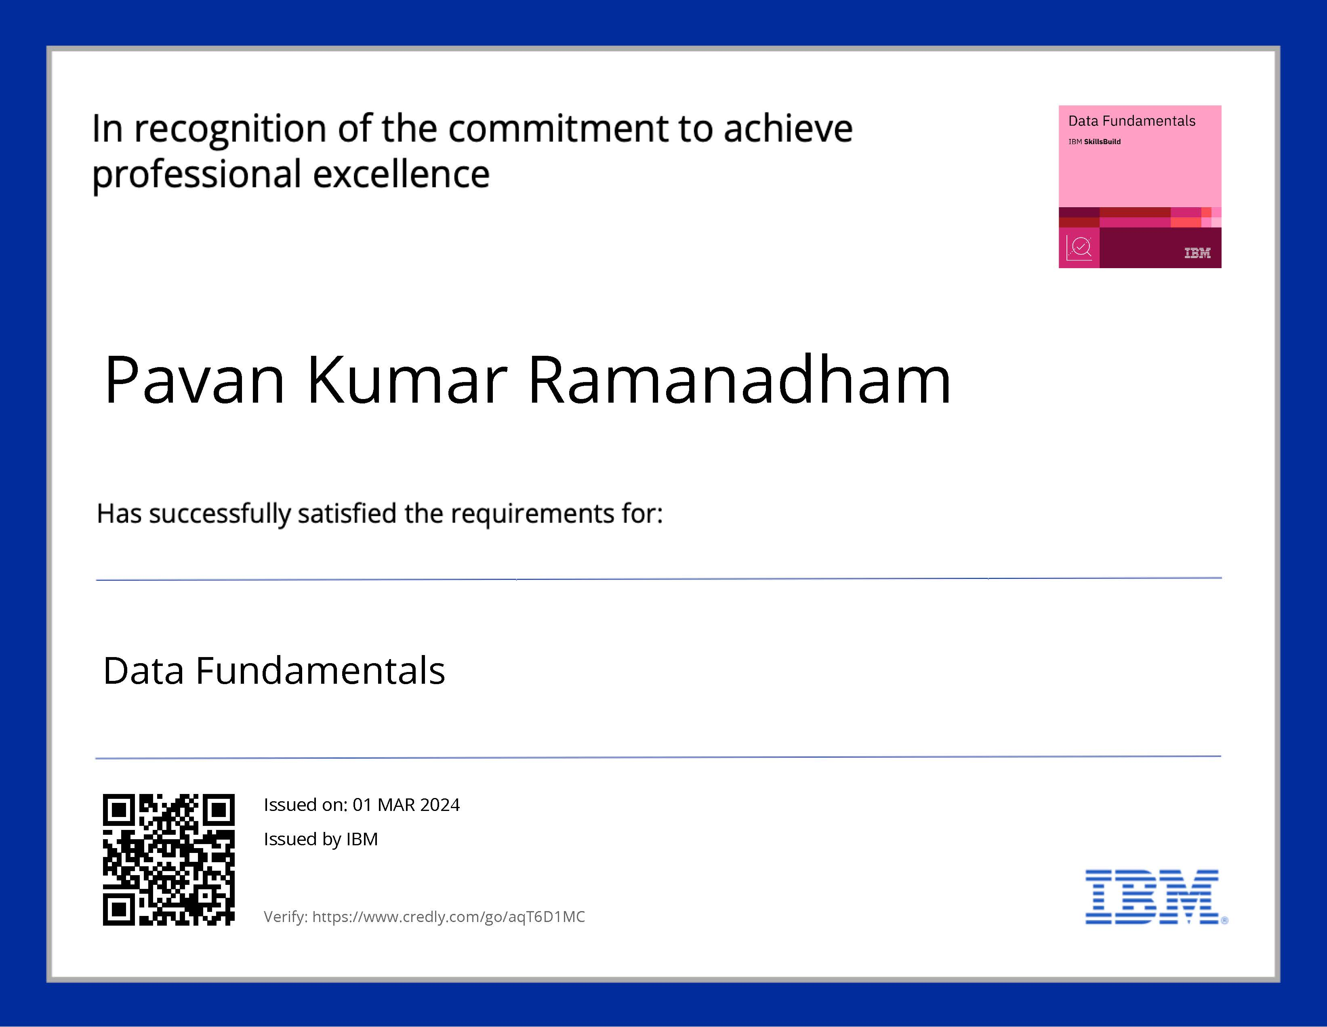
course certificate 2

Slide 13
THANK YOU

